Slide 1
BRIDGE CRACK DETECTION THROUGH UAV

Slide 2
TABLE OF CONTENT
01
02
03
04
05
Introduction
Dataset
Experiment
Results
Conclusion

Slide 3
01
Introduction

Slide 4
Introduction
Crack segmentation is a critical task in structure investigation problems such as bridge inspection projects.
The accuracy of the segmentation model is crucial in identifying potential regions of damage on the bridge surface from images captured by drones.
The task is challenging due to the presence of noise and other objects such as moss on cracks, title lines, etc., which can be wrongly identified as cracks.

Slide 5
02
Dataset

Slide 6
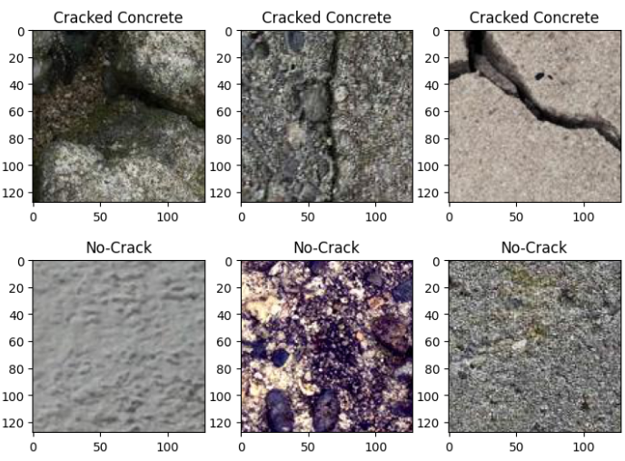
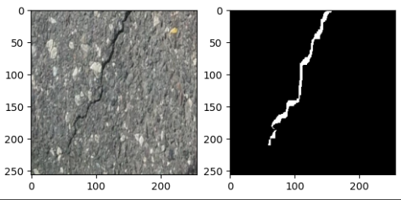
Dataset
Two datasets were used in this project:
Classification dataset and
Crack segmentation dataset.

Slide 7
Dataset
The classification dataset contains images collected from various sources and includes different types of cracks, such as longitudinal, transverse, and alligator cracks.
The dataset consists of over 300 high-resolution images labeled at the university and nine different segmentation crack datasets merged from the internet.
The images in the crack dataset contain noise and other objects such
as moss on cracks, title lines, etc., which can be wrongly
identified as cracks.

Slide 8
03
EXPERIMENT
Crack Classification
Crack Segmentation

Slide 9
Methodology 1
We developed a model based on a convolutional neural network (CNN) architecture.
Keras preprocessing image ImageDataGenerator was used for augmenting image datasets.
Images were normalized by dividing each pixel by 255 and data augmentation techniques like horizontal flip, shear_range=0.2, and zoom_range=0.2 were applied. The images were resized to 227x227.
The CNN architecture includes multiple convolutional layers, pooling layers, a flatten layer, and three fully connected layers.

Slide 10
Methodology 1
Layer (type) | Output Shape | Param #
conv2d (Conv2D) | (None, 223, 223, 6) | 456
activation (Activation) | (None, 223, 223, 6) | 0
average_pooling2d (AveragePooling2D) | (None, 111, 111, 6) | 0
conv2d_1 (Conv2D) | (None, 107, 107, 16) | 2416
activation_1 (Activation) | (None, 107, 107, 16) | 0
average_pooling2d_1 (AveragePooling2D) | (None, 53, 53, 16) | 0
flatten (Flatten) | (None, 44944) | 0
dense (Dense) | (None, 120) | 5393400
activation_2 (Activation) | (None, 120) | 0
dense_1 (Dense) | (None, 84) | 10164
activation_3 (Activation) | (None, 84) | 0
dense_2 (Dense) | (None, 1) | 85
activation_4 (Activation) | (None, 1) | 0
The final layer is a single neuron with a sigmoid activation function, which predicts the probability of the input image containing a crack.
The Model1 was trained on a crack detection dataset and achieved a test set accuracy of 92.5%, demonstrating its capability to accurately detect cracks in structures.

Slide 11
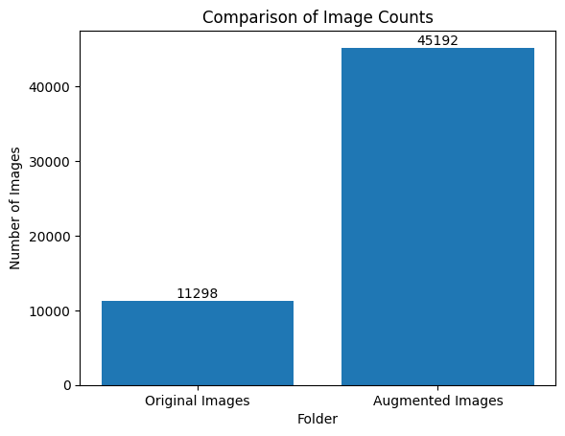
Methodology 2
This methodology focuses on crack detection through image segmentation using images and corresponding masks.
The dataset consisted of 11,298 images and masks.
To optimize memory usage, a custom batch processing technique was developed to augment and process each batch of images. This uses minimal RAM and processed 600 images per second, enhancing model training efficiency.

Slide 12
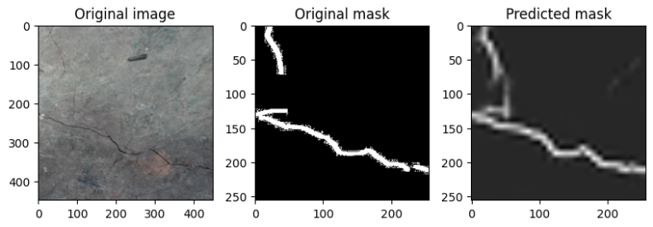
Methodology 2
The Resnet50 pre-trained model was fine-tuned for the specific use case for the image segmentation task.

Slide 13
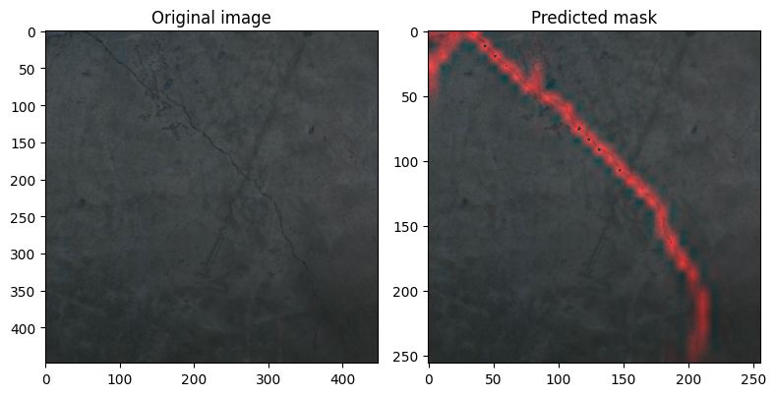
Methodology 2
Precision was measured as the ratio of true positives to the sum of true positives and false positives. Recall was computed as the ratio of true positives to the sum of true positives and false negatives.
Accuracy was calculated by determining the total number of pixels in the image, finding the absolute difference between the ground truth mask and the predicted mask, calculating the percentage of differing pixels, and subtracting this from 100.

Slide 14
04
Results

Slide 15
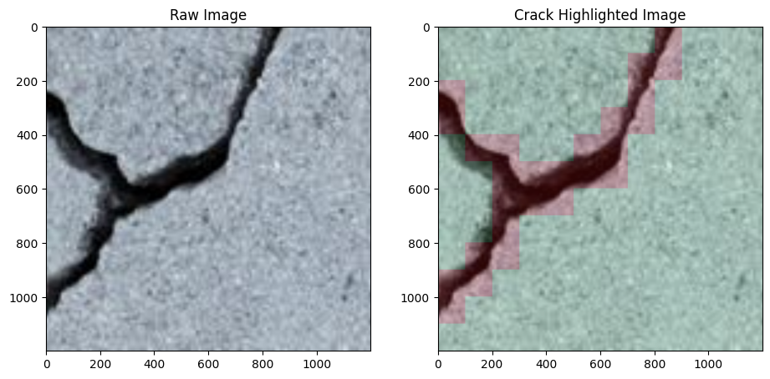
CRACK CLASSIFICATION

Slide 16
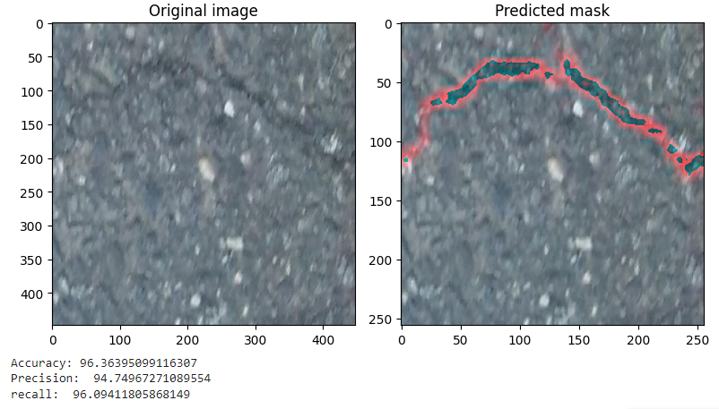
CRACK SEGMENTATION

Slide 17
CRACK SEGMENTATION
97.04%
96.49%
97.35%
Accuracy
Precision
Recall

Slide 18
05
Conclusion

Slide 19
Conclusion
Overall, the deep learning model and image segmentation technique developed in this project showed promising results in crack detection in concrete structures. Despite its promising results, the proposed approach has several limitations.

Slide 20
Thankyou!
Peddamallu Yeshwanth Reddy
GitHub: NotYeshwanthReddy

